Slide 1
Unit 1 -Introduction to software testing
Raghu Prasad K S
www.kaushalya.tech
9845547471

Slide 2
Introduction
Raghu Prasad – BE, MS
Total of 30 years of experience
7 years as a lecturer in Engineering College
23 Years into IT
Worked with companies like CISCO,CSC,ICICI,First Apex – NTT Data
Currently into Corporate training and consultancy
Worked with corporates and public sector
Technologies – Java,Python,C#,AI,ML,Data Analytics,Cloud Computing,Web technologies,Java Script technologies (MEAN stack),IOT,Test Automation – Selenium,JMeter

Slide 3
Agenda
What is Software Testing ?
Types of Software Testing.
Significance of Software Testing.
Software Development Life Cycle (SDLC)
Phases in software development life cycle
Waterfall and Agile method of software development
Scrum methodology of agile software development
Software Testing Life Cycle (STLC)

Slide 4
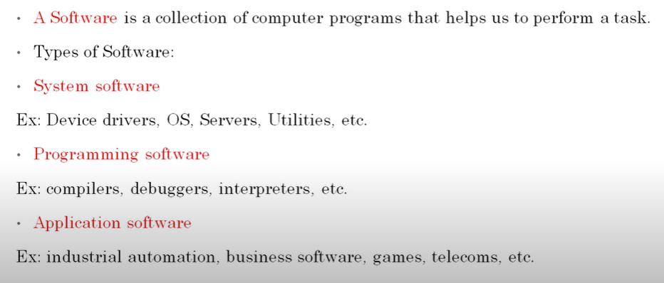
What is Software ?

Slide 5
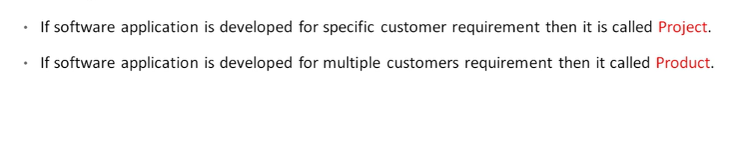
Project Vs Product

Slide 6
What is Software Testing ?
What is Software Testing?
Software Testing is a method to assess the functionality of the software program. The process checks whether the actual software matches the expected requirements and ensures the software is bug-free. The purpose of software testing is to identify the errors, faults, or missing requirements in contrast to actual requirements. It mainly aims at measuring the specification, functionality, and performance of a software program or application.
Software testing can be divided into two steps:
Verification: It refers to the set of tasks that ensure that the software correctly implements a specific function. It means “Are we building the product right?”.
Validation: It refers to a different set of tasks that ensure that the software that has been built is traceable to customer requirements. It means “Are we building the right product?”

Slide 7
Importance of Software Testing
Defects can be identified early: Software testing is important because if there are any bugs that can be identified early and can be fixed before the delivery of the software.
Improves quality of software: Software Testing uncovers the defects in the software, and fixing them improves the quality of the software.
Increased customer satisfaction: Software testing ensures reliability, security, and high performance which results in saving time, costs, and customer satisfaction.
Helps with scalability: Software testing type non-functional testing helps to identify the scalability issues and the point where an application might stop working.
Saves time and money: After the application is launched it will be very difficult to trace and resolve the issues, as performing this activity will incur more costs and time. Thus, it is better to conduct software testing at regular intervals during software development.

Slide 8
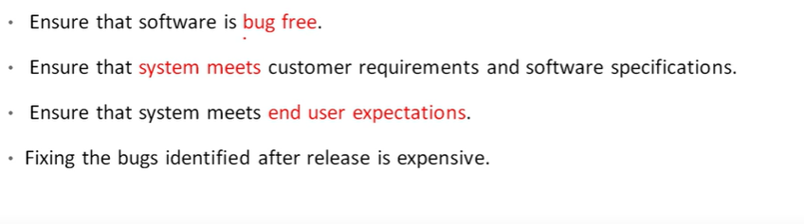
Why software testing is needed?

Slide 9
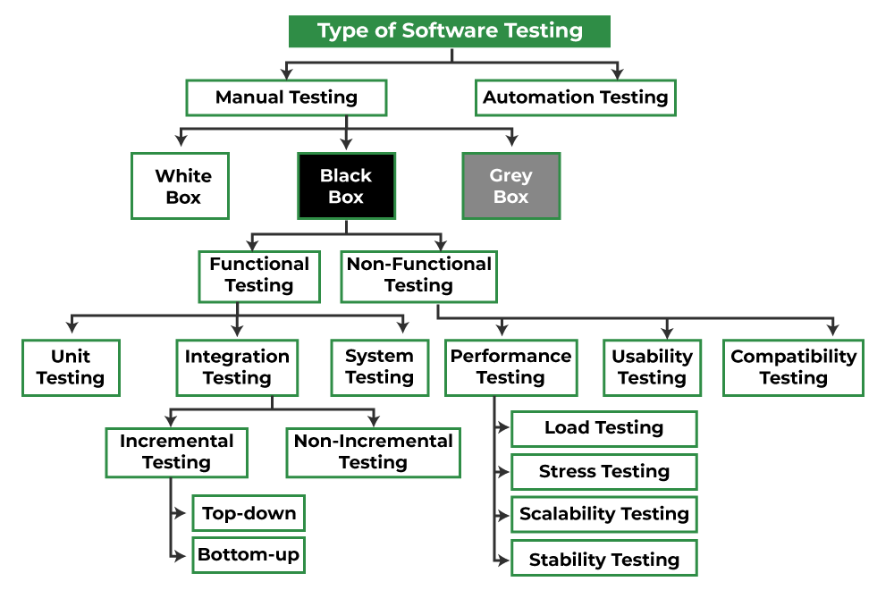
Different Types of Software Testing

Slide 10
Different Types of Software Testing
Manual Testing: Manual testing includes testing software manually, i.e., without using any automation tool or script. In this type, the tester takes over the role of an end-user and tests the software to identify any unexpected behavior or bug. There are different stages for manual testing such as unit testing, integration testing, system testing, and user acceptance testing. Testers use test plans, test cases, or test scenarios to test software to ensure the completeness of testing. Manual testing also includes exploratory testing, as testers explore the software to identify errors in it.
Automation Testing: Automation testing, which is also known as Test Automation, is when the tester writes scripts and uses another software to test the product. This process involves the automation of a manual process. Automation Testing is used to re-run the test scenarios quickly and repeatedly, that were performed manually in manual testing. Apart from regression testing, automation testing is also used to test the application from a load, performance, and stress point of view. It increases the test coverage, improves accuracy, and saves time and money when compared to manual testing.

Slide 11
Different Types of Software Testing
Black Box Testing: Black box technique of testing in which the tester doesn’t have access to the source code of the software and is conducted at the software interface without any concern with the internal logical structure of the software known as black-box testing.
White-Box Testing: White box technique of testing in which the tester is aware of the internal workings of the product, has access to its source code, and is conducted by making sure that all internal operations are performed according to the specifications is known as white box testing.
Grey Box Testing: Grey Box technique is testing in which the testers should have knowledge of implementation, however, they need not be experts.

Slide 12
Different Types of Software Testing
Unit Testing: Unit testing is a level of the software testing process where individual units/components of a software/system are tested. The purpose is to validate that each unit of the software performs as designed.
Integration Testing: Integration testing is a level of the software testing process where individual units are combined and tested as a group. The purpose of this level of testing is to expose faults in the interaction between integrated units.
System Testing: System testing is a level of the software testing process where a complete, integrated system/software is tested. The purpose of this test is to evaluate the system’s compliance with the specified requirements.
Acceptance Testing: Acceptance testing is a level of the software testing process where a system is tested for acceptability. The purpose of this test is to evaluate the system’s compliance with the business requirements and assess whether it is acceptable for delivery.

Slide 13
Benefits of Software Testing
Product quality: Testing ensures the delivery of a high-quality product as the errors are discovered and fixed early in the development cycle.
Customer satisfaction: Software testing aims to detect the errors or vulnerabilities in the software early in the development phase so that the detected bugs can be fixed before the delivery of the product. Usability testing is a type of software testing that checks the application for how easily usable it is for the users to use the application.
Cost-effective: Testing any project on time helps to save money and time for the long term. If the bugs are caught in the early phases of software testing, it costs less to fix those errors.
Security: Security testing is a type of software testing that is focused on testing the application for security vulnerabilities from internal or external sources.

Slide 14
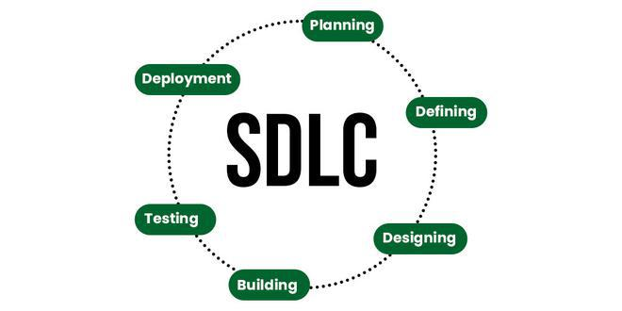
Software Development Life Cycle (SDLC)
Software development life cycle (SDLC) is a structured process that is used to design, develop, and test good-quality software. SDLC, or software development life cycle, is a methodology that defines the entire procedure of software development step-by-step.

Slide 15
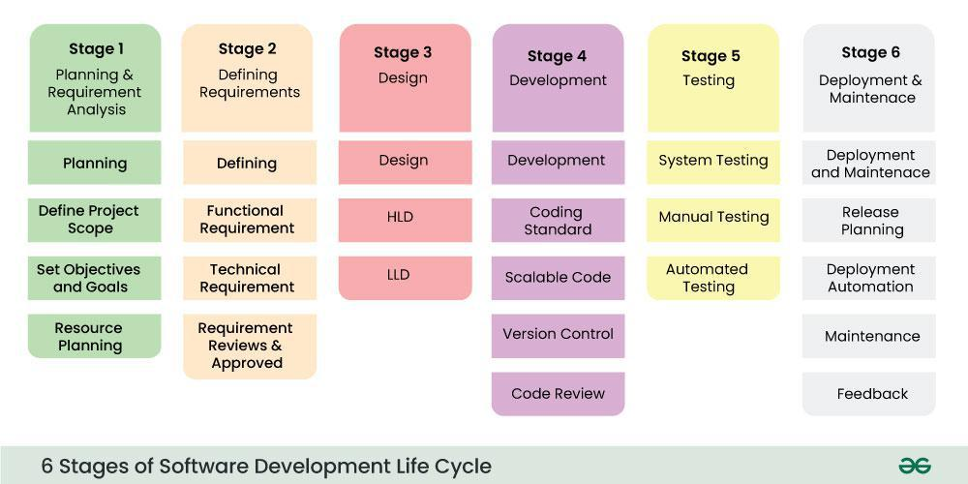
Stages of SDLC
SDLC specifies the task(s) to be performed at various stages by a software engineer or developer. It ensures that the end product is able to meet the customer’s expectations and fits within the overall budget. Hence, it’s vital for a software developer to have prior knowledge of this software development process.

Slide 16
SDLC Models
1. Waterfall Model
It is the fundamental model of the software development life cycle. This is a very simple model. The waterfall model is not in practice anymore, but it is the basis for all other SDLC models. Because of its simple structure, the waterfall model is easier to use and provides a tangible output. In the waterfall model, once a phase seems to be completed, it cannot be changed, and due to this less flexible nature, the waterfall model is not in practice anymore.
2. Agile Model
The agile model was mainly designed to adapt to changing requests quickly. The main goal of the Agile model is to facilitate quick project completion. The agile model refers to a group of development processes. These processes have some similar characteristics but also possess certain subtle differences among themselves.
3. Iterative Model
In the iterative model, each cycle results in a semi-developed but deployable version; with each cycle, some requirements are added to the software, and the final cycle results in the software with the complete requirement specification.

Slide 17
SDLC Models
4. Spiral Model
The spiral model is one of the most crucial SDLC models that provides support for risk handling. It has various spirals in its diagrammatic representation; the number of spirals depends upon the type of project. Each loop in the spiral structure indicates the Phases of the Spiral model.
5. V-Shaped Model
The V-shaped model is executed in a sequential manner in V-shape. Each stage or phase of this model is integrated with a testing phase. After every development phase, a testing phase is associated with it, and the next phase will start once the previous phase is completed, i.e., development & testing. It is also known as the verification or validation model.
6. Big Bang Model
The Big Bang model in SDLC is a term used to describe an informal and unstructured approach to software development, where there is no specific planning, documentation, or well-defined phases.

Slide 18
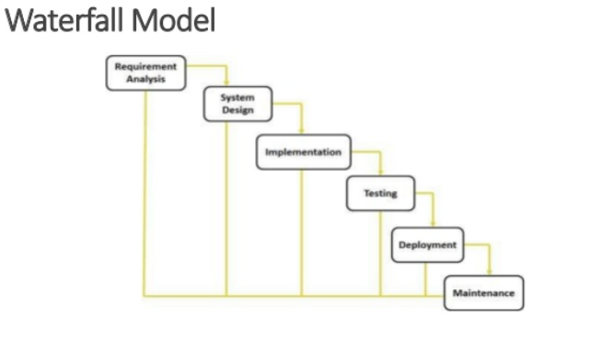
SDLC Models - Waterfall

Slide 19
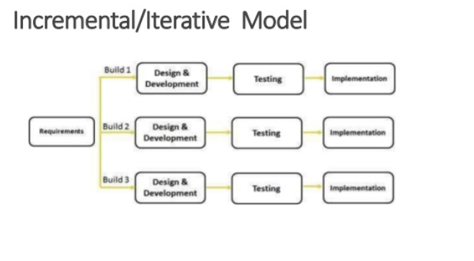
SDLC Models – Iterative Model

Slide 20
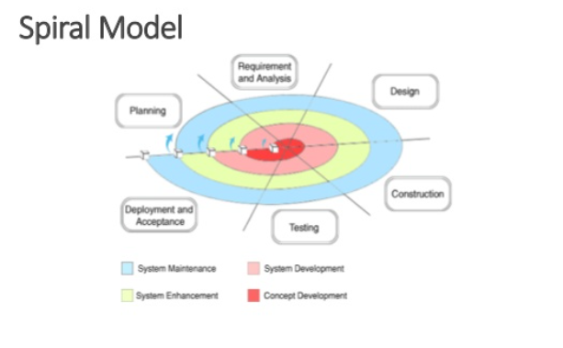
SDLC Models – Spiral Model

Slide 21
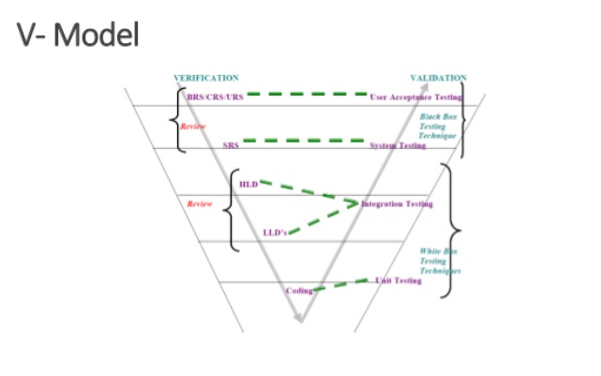
SDLC Models – V Model

Slide 22
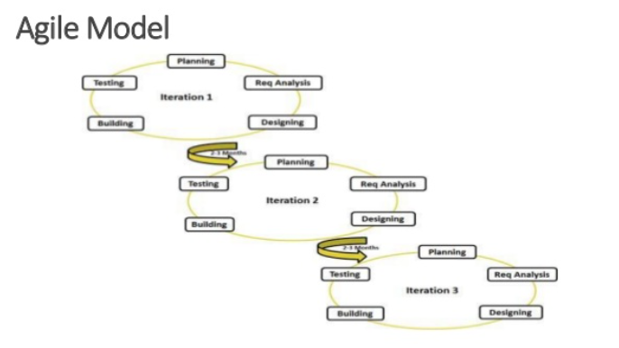
SDLC Models – Agile Model

Slide 23
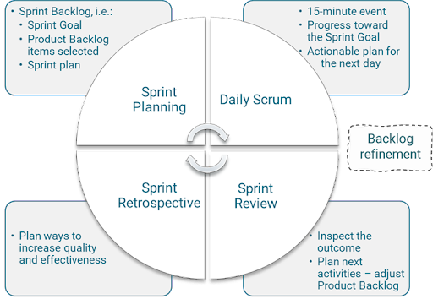
Scrum

Slide 24
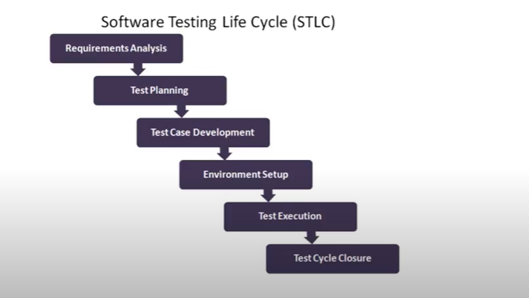
STLC

Slide 25
Reference
https://www.geeksforgeeks.org/software-testing-basics/
https://www.geeksforgeeks.org/bug-life-cycle-in-software-development/

